Slide 1

Session 2 DONE! Session 3: The Re-sesssion

Slide 2




Session 3: The Re-sesssion
Where we think we are
Where we actually are
Where we want to be

Slide 3
Environment
echo ${PWD} # Path to/of Working Directory
echo ${USER} # Username
echo ${HOSTNAME} # Name of the machine we are currently on
echo ${HOME} # The HOME directory, the place you go to when loggin in # You can also use ~ as a substation for ${HOME}

Slide 4

Environment
The most important variable in a linux session is PATH. PATH is nothing more than a list of folders, however when you type in ANYTHING as a tool (i.e. without declaring it’s anything other than a software/tool), for example ‘mkdir’ or ‘cd’, linux will lookup if those words are found ANYWHERE in the list of directories in PATH.
The first folder in which linux finds the word you typed, it will assume that that is the software you want to use
You can compare PATH to windows explorer/start search bar. If you type in a piece of software, you see the top hits, linux however only find the exact matches, so be carefull what you type ;)

Slide 5
Environment
echo ${PATH} # List of all the directories to look in to find commands/tools
PATH=/mnt/archgen/users/lesley_sitter/miniconda3/bin:/mnt/archgen/users/lesley_sitter/miniconda3/bin:/mnt/archgen/users/lesley_sitter/miniconda3/condabin:/mnt/archgen/users/lesley_sitter/Software/Module/bin:/mnt/archgen/users/lesley_sitter/perl5/bin:/mnt/archgen/users/lesley_sitter/.local/bin:/r1/people/lesley_sitter/Software/*/bin:/r1/people/lesley_sitter/Software/*:/opt/sge/bin:/opt/sge/bin/lxamd64:/home/bioinf/usr/bin:/home/public/usr/bin:/usr/sbin:/usr/bin:/sbin:/bin:/usr/games:/usr/local64/bin:/usr/local/bin:/usr/sbin:/usr/bin:/sbin:/bin:/usr/bin/X11:/usr/games

Slide 6
PATH=/mnt/archgen/users/lesley_sitter/miniconda3/bin:
/mnt/archgen/users/lesley_sitter/miniconda3/bin:
/mnt/archgen/users/lesley_sitter/miniconda3/condabin:
/mnt/archgen/users/lesley_sitter/Software/Module/bin:
/mnt/archgen/users/lesley_sitter/perl5/bin:
/mnt/archgen/users/lesley_sitter/.local/bin:
/r1/people/lesley_sitter/Software/*/bin:
/r1/people/lesley_sitter/Software/*:
/opt/sge/bin:
/opt/sge/bin/lxamd64:
/home/bioinf/usr/bin:
/home/public/usr/bin:
/usr/sbin:
/usr/bin:
Etc…

Slide 7

Environment
echo ${SHELL} # The language interpreter that interprets all your STDin and commands

Slide 8
Last thingS!
Downloading shit and zipping/unzipping/untarring etc
Files are normally stored on what we call repositories (github and ncbi/refseq being the most known).
Downloading is often complicated, but in some cases we can get away with just copying the link to the file and using wget to GET it from the Web (WebGET) wget https://github.com/rhuebler/HOPS/releases/download/0.35/hops0.35.tar.gz

Slide 9
Unzipping
Files are normally stored on what we call repositories (github and ncbi/refseq being the most known).
For example, hops0.35.tar.gz ends in .tar.gz tar is short for tarball, and gz is an extention of gzip.
To unzip it there are essentially two steps, the first it to resolve the .gz using gunzip gunzip hops0.35.tar.gz
That leaves us with hops0.35.tar, which we can untar using tar –xvf hops0.35.tar
Luckily for us the developers of tar are nice and allow us to combined the two steps :P Just add the option -z tar –zxvf hops0.35.tar.gz

Slide 10
Counting lines = OVERPOWERED!!!
wc –l will count lines for you wc –l file.txt or you can pipe ls into it to count files in a folder ls file*.txt | wc –l
We only have 10 fingers to count on, so having a way to keep track of LARGE number of lines in a file or sets of files is very powerfull to check if you did everything correctly

Slide 11
Cool beans… what now?
Bash done, environment set! Let’s submit stuff to the servers using this information!!!
But first… what even is a server???????

Slide 12
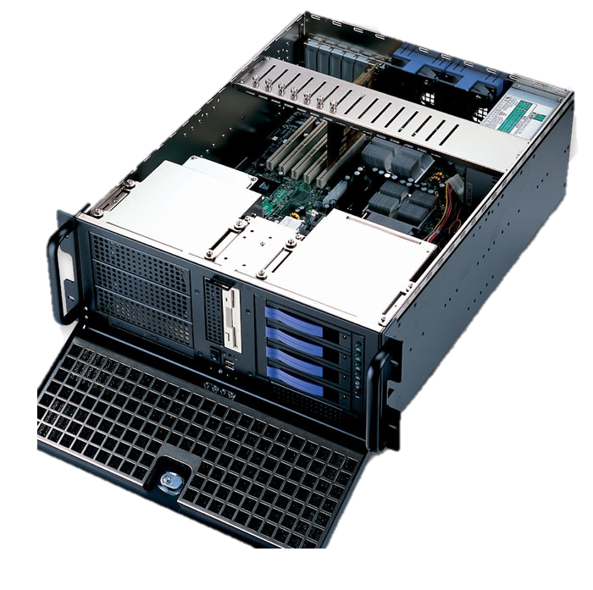

Slide 13
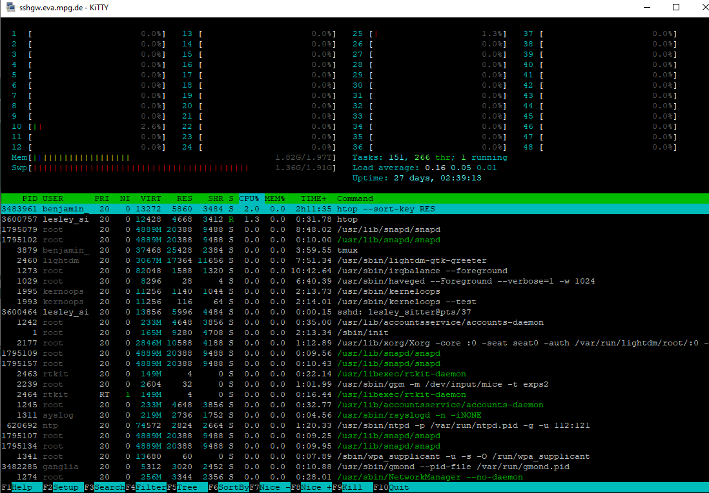
top
htop

Slide 15
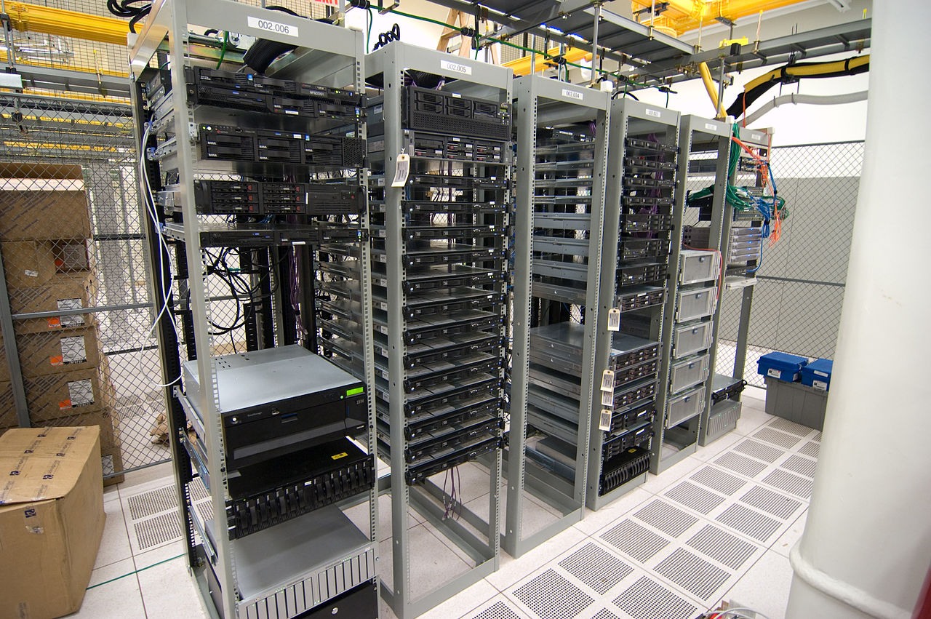

Slide 16

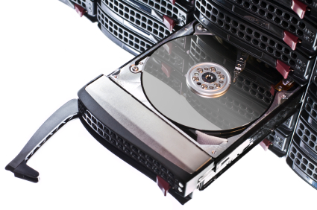

Slide 17




Slide 18
bionc14 16CPU 503Gb
bionode01-06
64CPU 755Gb
bionc04 48CPU 503Gb
/mnt/archgen/
Permanent storage
bionc11 48CPU 1Tb
bionc13 48CPU 2Tb
bionode07-08
112CPU 2Tb
bionode27 128CPU 1Tb
bionode01-34
24CPU 47Gb
bionode35-67
32/36CPU
125-376Gb
/mnt/scratch/
Temporary hdd space meant for I/O heavy jobs
bio01-97
8CPU 15Gb
Not usable
all.q
all.q, archgen.q
Sun Grid Engine (SGE), using two different queus (all.q for everyone, archgen.q exclusively for us) qsub (queue submission)

Slide 19
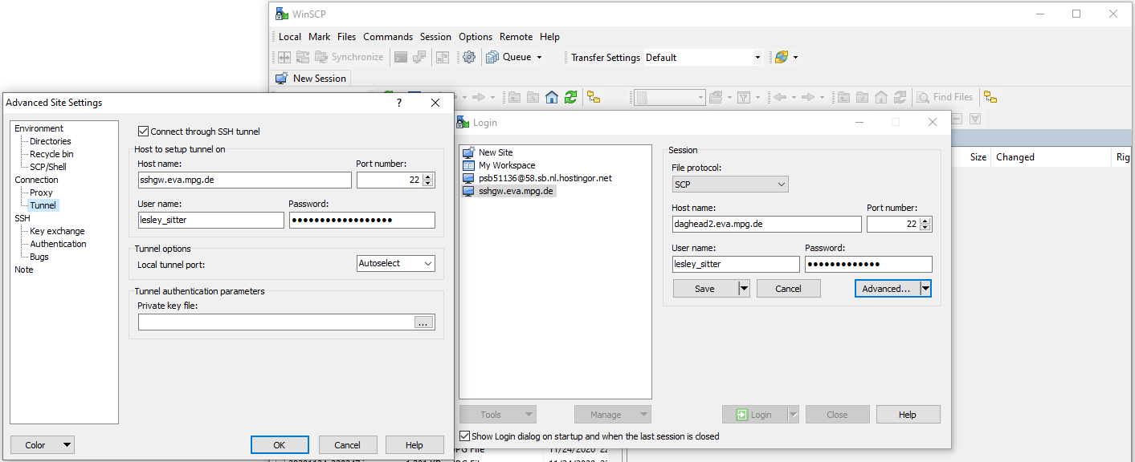
ssh daghead2.eva.mpg.de
Use of ‘scp’ and ‘sshfs’ cumbersome. Use WinSCP (windows) or FileZilla (ubuntu) and setup a tunnel
For MAC you can use CyberDuck
Ignore this left window with 3 errors, you can now directly type in only the right window as long as you are on the VPN, otherwise the left way is still acceptable I think
Your password here is the same as for kitty/putty as it’s the same type of connection (ssh)

Slide 20

Your one and only friend
https://kbase.eva.mpg.de/xwiki/bin/view/Departments/Archaeogenetics/
Also recommend evernote to keep a brain-farts and code snippets in the
Cloud: https://www.evernote.com
Honourable mentions:
https://www.biostars.org/ http://seqanswers.com/ (old)

Slide 21
# You can fun a command on the cluster by writing it as followed
qsub -q archgen.q -b y -cwd [command]
# here [command] can be anything that you can run on the terminal
# -q just represent the "queue" that we line up in, so for the DAG machines, we line up in the DAG queu which is called archgen.q
# -b Y (Y=yes) is to signify that we want to run a command, not a script
# -cwd is current working directory
# If something is gonna take a long time, is gonna take a lot of CPU or need to do a lot of parrallel process, then use qsub.
# You should try to avoid working on the "head node" (bionc21/22)

Slide 22
# You can see the status of your submission using qstat
qstat -u your_username
# You can also see ALL the jobs and how busy it is by leaving the -u your_username out
qstat
# Each job gets a number associated, and you can see that when you run qstat -u your_username
# but sometimes you only want to see the status of 1 single job, you can then use the -j option
qstat -j your_jobnumber

Slide 23
# Sometimes you want to see the information of a job AFTER it already finished. Unfortunately
# qstat doens't keep that information as that would get too cluttered. Instead you can use the accounting
# function qacct
qacct -j your_jobnumber
# or if you want to see more of a general overview of what you have used up previously you can look at the user overview
qacct -u your_username
# If you are unsure what type of hardware these machines have you can use qhost
qhost
# Let's say you need a specific amount of memory or cpu power and you see there are 3 systems that can handle it
# but you are unsure whether these systems are busy, you can look at specific resources using a pile and grep qstat -f | grep bionc22

Slide 24
# Most of the times to both speed up the process, and not HOG the machine, we limit our request to what we need
# We specify the number of cpu's and memory we need so our jobs stay as small as possible and get in the queue quicker
# And we are also being kind towards others by not clogging up the big machines with jobs that don’t actually do anything
# This part takes a bit of trial and error to figure out how much you need.
# We can specify cpu with the confusing option -pe smp [cpu_number]
# We can specify the memory with the equally confusing option -l h_vmem=[memory_number]T/G/M
# The formatting is also weird, one has a space, the other has an = sign... just roll with it :P
# So if we need 4 cpu's (or threads or cores... they are all different things, but often used to mean the same thing, chips on a pc that process data)
# and we need 8Gb of memory
qsub -q archgen.q -cwd -pe smp 2 -l h_vmem=8G script.sh

Slide 25
# If we run a script we don't have to type these options out every time, there is a way to put it in the script for qsub to read, it's a bit confusing
# but if we start the script with a list of command and use #$ qsub will know that these are special lines meant for qsub to interpret as options

Slide 26
#$ -S /bin/bash #defines bash as the shell for execution
#$ -N MyCommand #Name of the command that will be listed in the queue
#$ -cwd #change to current directory
#$ -j y #join error and standard output in one file, no error file will be written #$ -o output #standard output file or directory (joined with error because of -j y)
#$ -q archgen.q #queue
#$ -m e #send an email at the end of the job #$ -M username@eva.mpg.de #send email to this address
#$ -pe smp 8 #needs 8 CPU cores #$ -l h_vmem=4G #request 4Gb of memory
#$ -V # load personal profile

Slide 27
# To view available resources
qhost -F
# To view currently running jobes on a node (for example Bionode27
qstat -f | grep bionode27
# View User jobs qstat -u lesley_sitter
# View specific job qstat -j ###### #Get job info afterwards qacct -j <jobid> | grep "maxvmem"
# qsub variables
when using qsub -t 1-10:1 $TASK_ID and $SGE_TASK_ID

Slide 28


